Slide 1
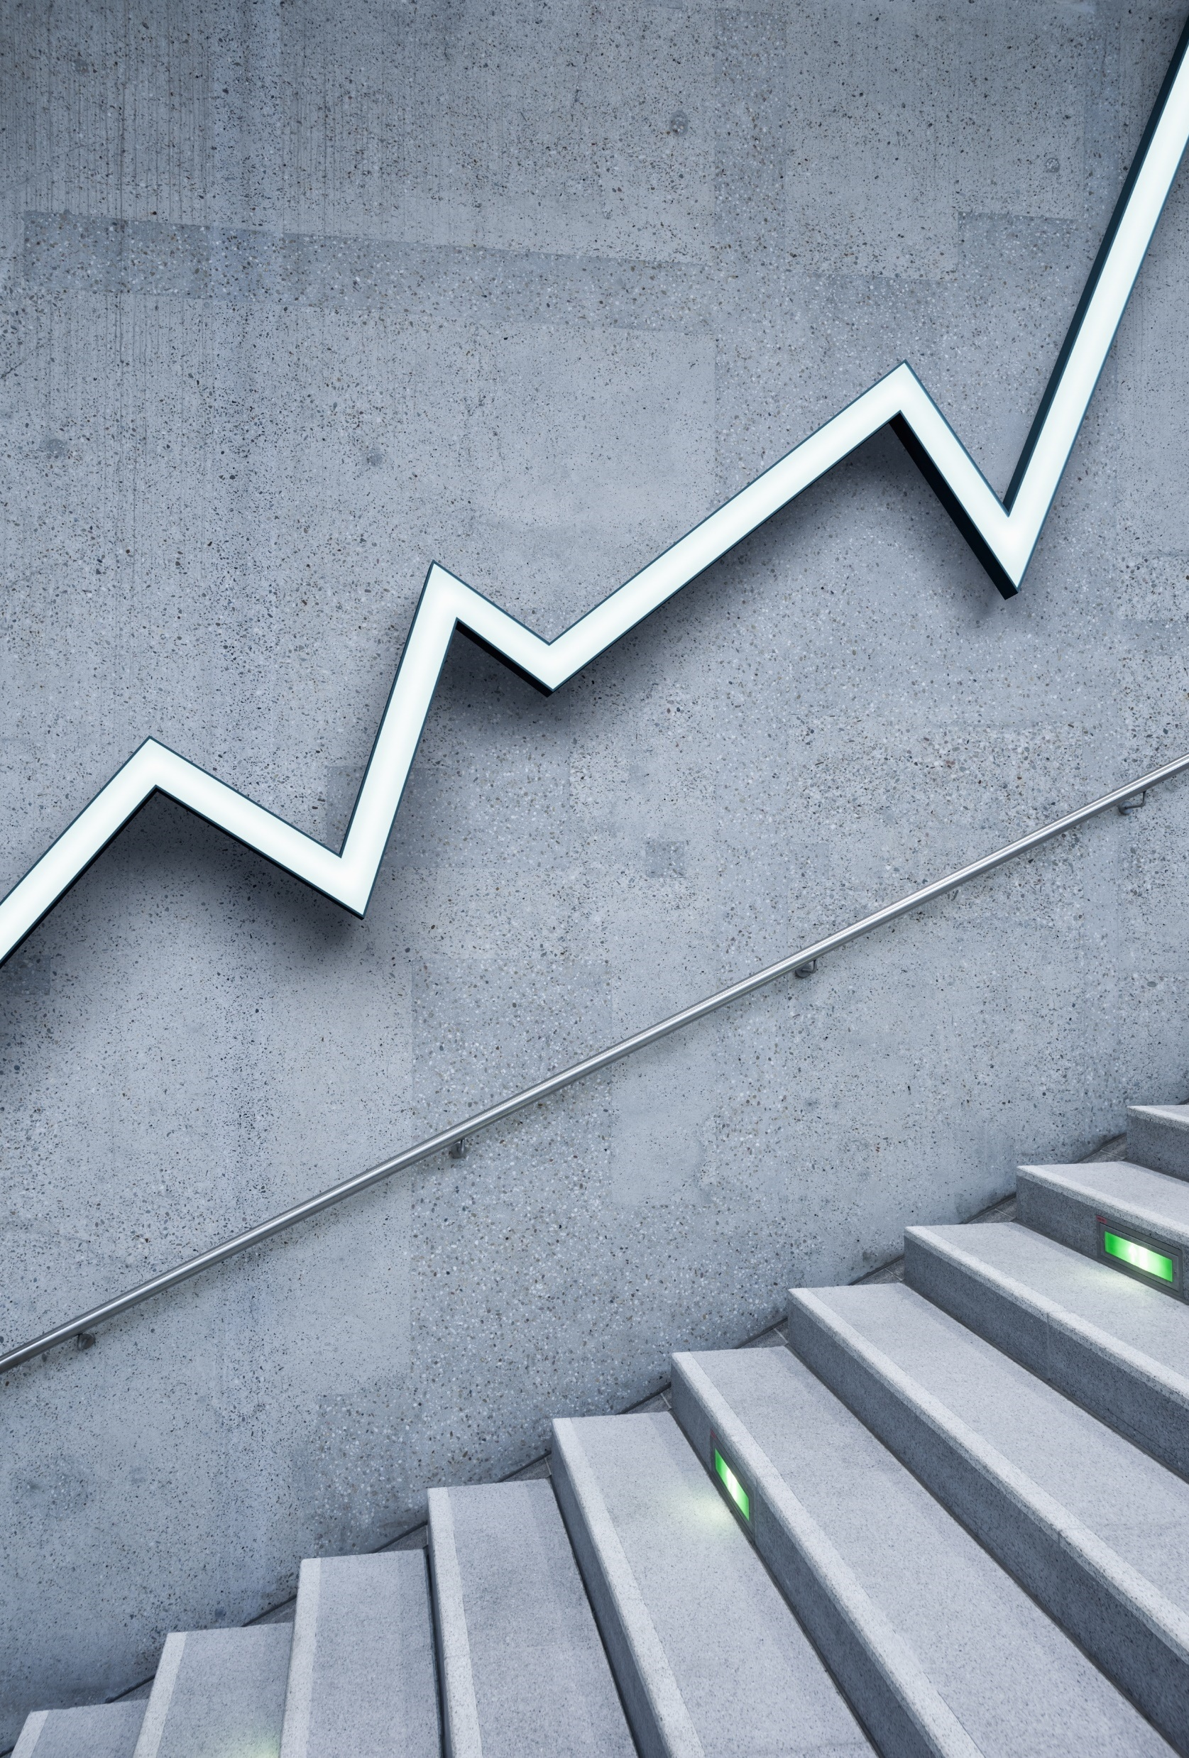
AI vs Active
Capped swix (benchmark)

Slide 2
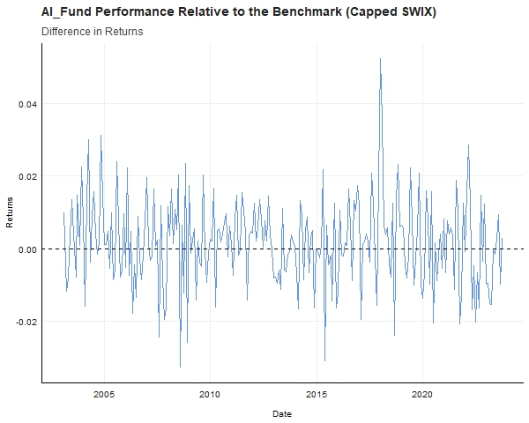
AI Performance to the Benchmark
This graph takes the absolute difference between the AI Fund and the Capped SWIX.
We note that the AI Fund varies much more than the benchmark, as there are periods of growth and pain. This type of movement is most likely inducing the Ostrich Effect in investors.

Slide 3
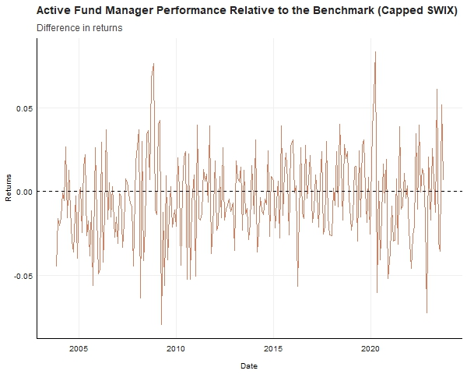
Active Performance to the Benchmark
This graph takes the absolute difference between the Active Fund managers and the Capped SWIX. We assumed that fees for active managers are around 1%, and this has been taken off the returns.
It seems that active managers underperform the benchmark most of the time.
There are clear differences between the returns of each fund.

Slide 4
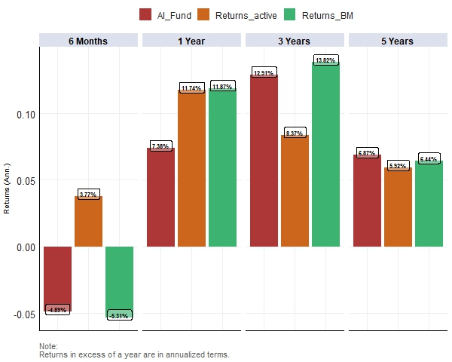
Annualised Returns
The figure on the right displays the fund movement throughout time. This provides us with a better indication of the consistency of returns.

Slide 5
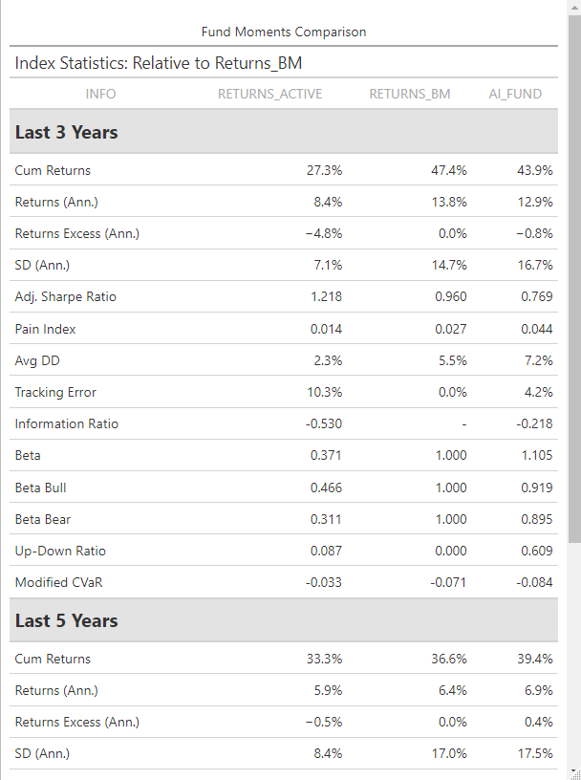
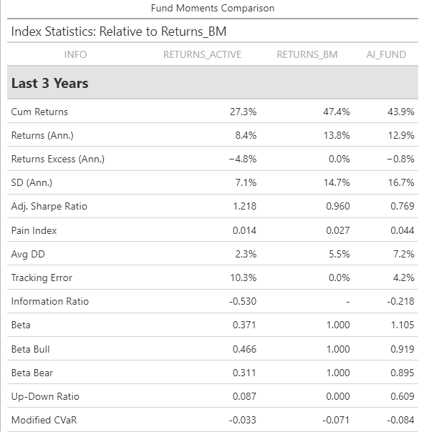
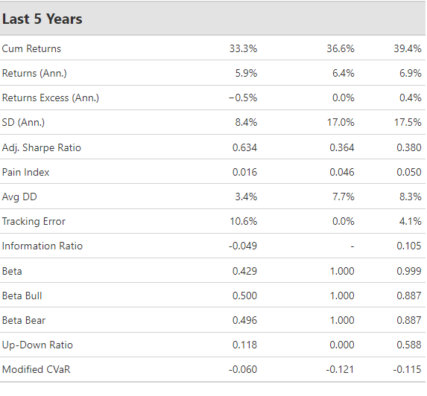
Statistical Comparisons between Each Fund Type

